Slide 1


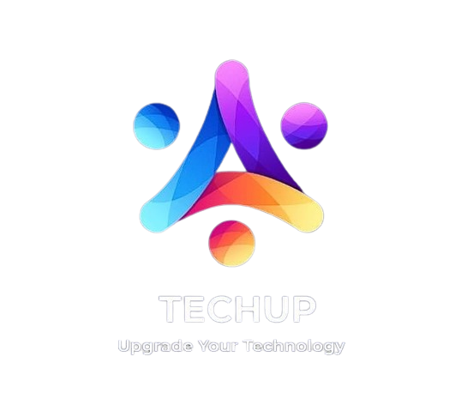

techup
TECHUP IS YOUR ALL-IN-ONE SOLUTION FOR SELECTING AND CONSTRUCTING COMPUTERS, OFFERING OPTIMAL PERFORMANCE AND COST-EFFECTIVENESS FOR BUILDING YOUR PC.
AKSHAT VERMA
ANSH VARMA
ADITYA MALIK
ANANT TELTIA
ABHISHEK PASWAN
AARUSH GAUR
Final Project Submission

Slide 2


14
1.DISCOVER

Slide 3


Problem Statement
Solution Statement
13
IN AN ERA OF RAPID TECHNOLOGICAL ADVANCEMENT, USERS EXPECT PERSONAL COMPUTERS TO KEEP PACE, NECESSITATING ADVANCED DESIGNS THAT ENHANCE PERFORMANCE, EFFICIENCY, AND FEATURES.
ESCALATING CYBERSECURITY THREATS MAKE IT IMPERATIVE TO DEVELOP SELF-PCS WITH ROBUST SECURITY FEATURES TO SAFEGUARD SENSITIVE DATA AND PRIVACY..
REGULATORY REQUIREMENTS FOR TECHNOLOGY, INCLUDING DATA PRIVACY AND ENVIRONMENTAL SUSTAINABILITY, MUST BE MET TO ACCESS MARKETS AND ENSURE COMPLIANCE. THE HIGHLY COMPETITIVE PERSONAL COMPUTER MARKET DEMANDS INNOVATIVE SOLUTIONS TO DIFFERENTIATE FROM COMPETITORS AND SUCCEED.
Our group has developed a cutting-edge Self-PC solution, prioritizing performance, efficiency, and security.
To ensure market compliance, we address regulatory requirements related to technology, data privacy, and environmental sustainability
Additionally, our solution boasts features such as a Component Compatibility Checker, Price Comparison tool, Budget Configurator, Educational Resources, Customization Options, Community and Reviews, Price Tracking, User Profiles, Performance Metrics, and a Virtual Machine Builder.
This comprehensive approach empowers users to build high-quality, secure, and customized PCs while staying informed and within budget.

Slide 4

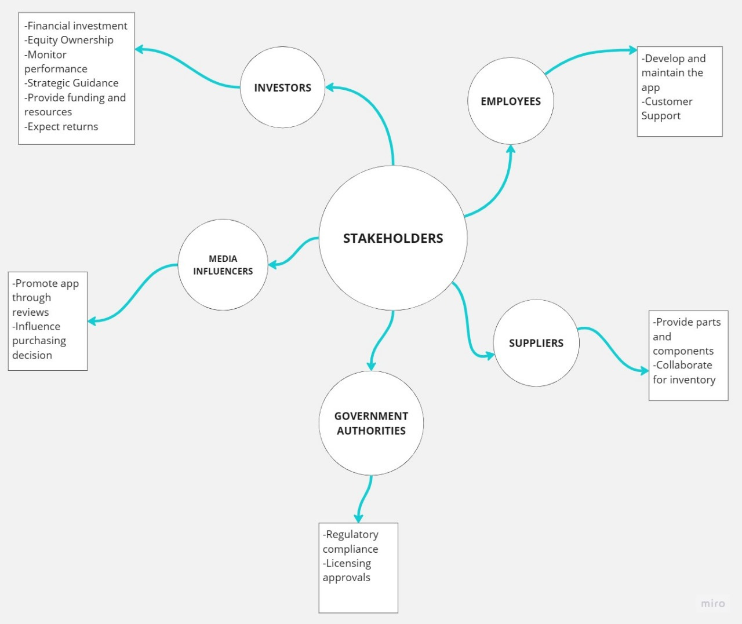
Stakeholders and their roles

Slide 5
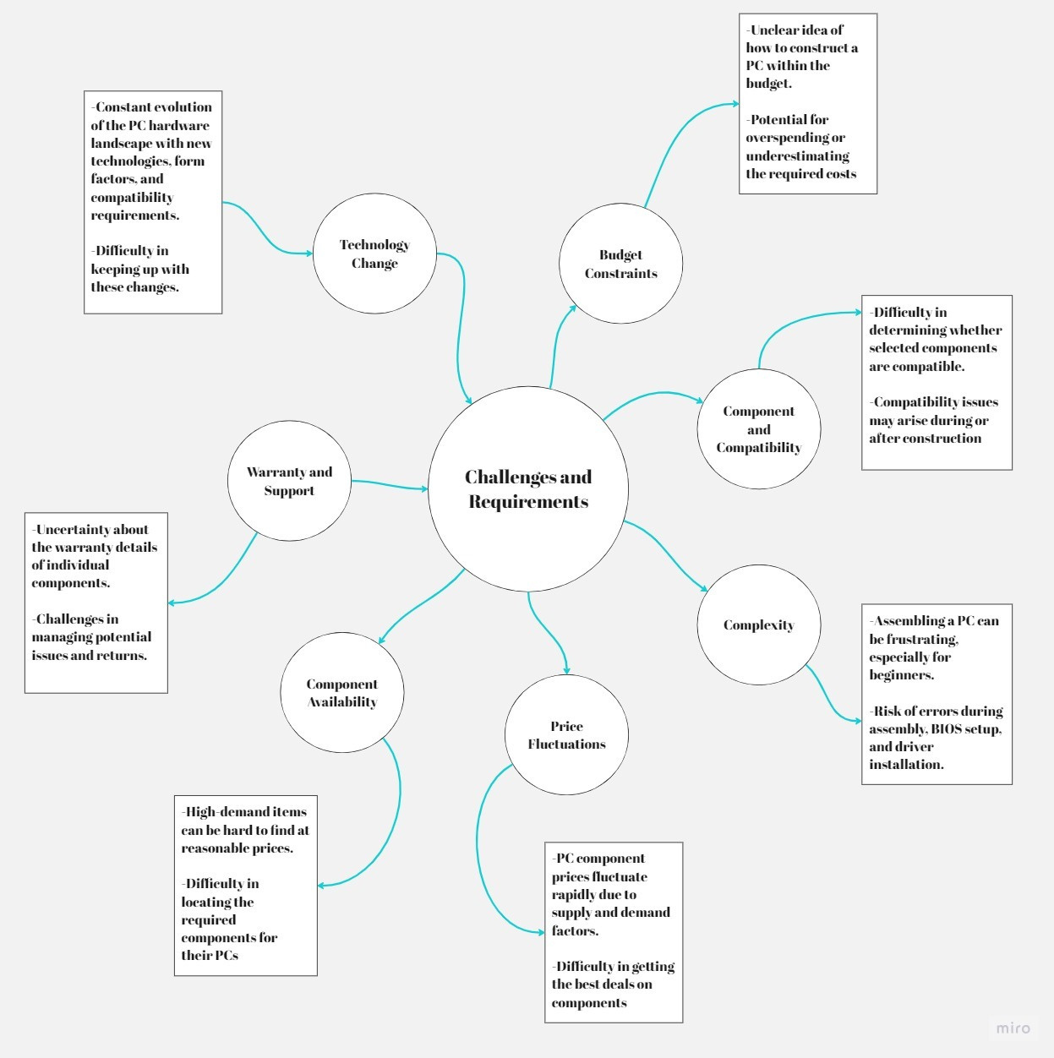

Challenges & Requirements

Slide 6
14
2.DEFINE

Slide 7

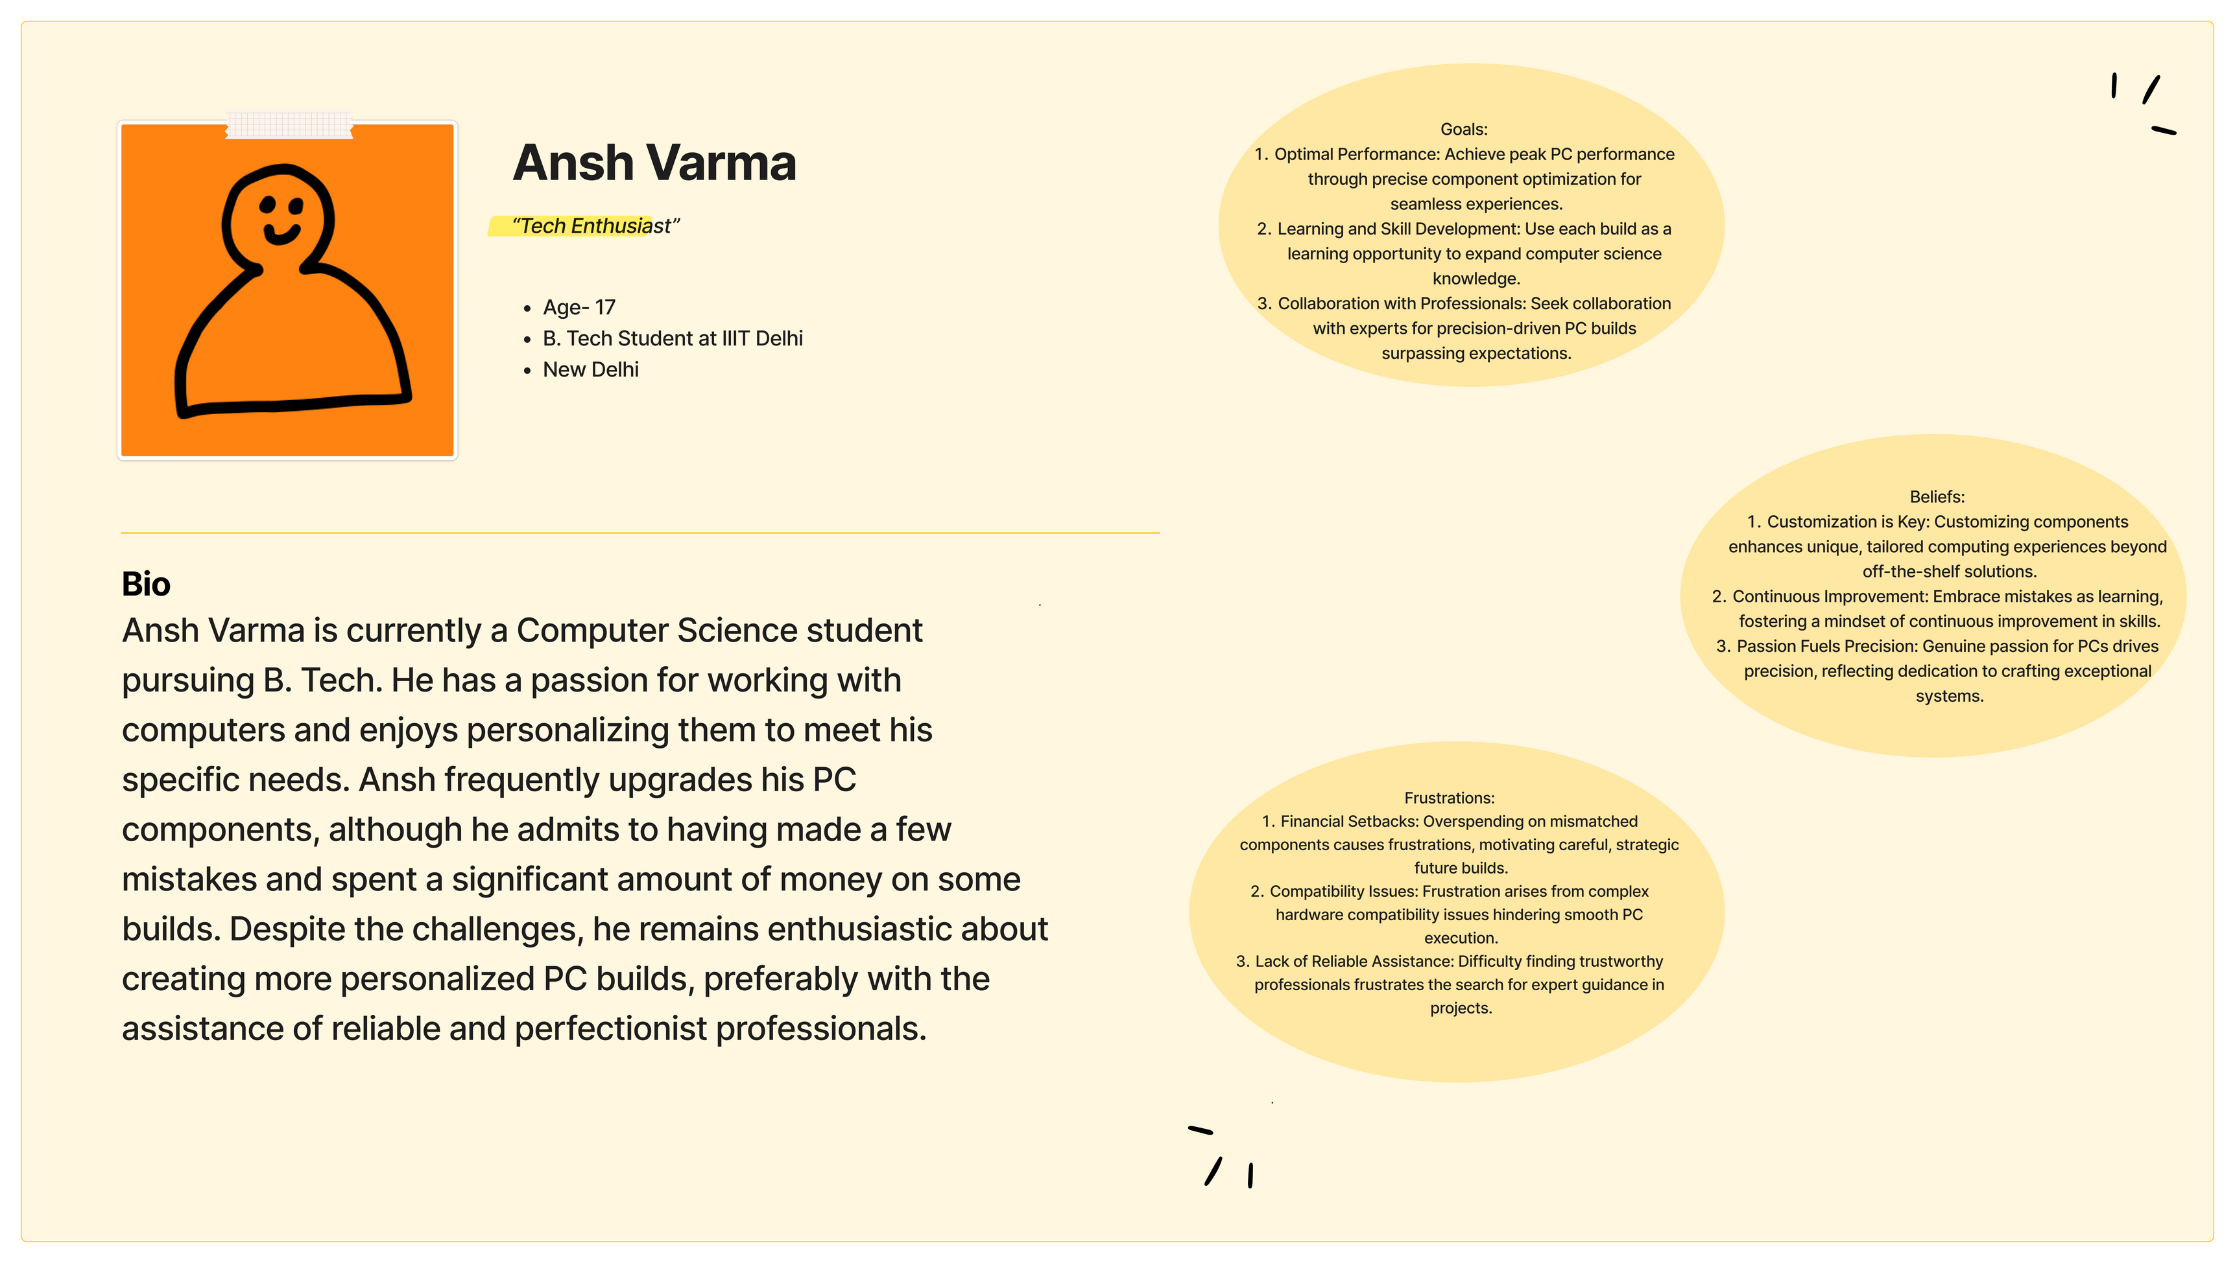
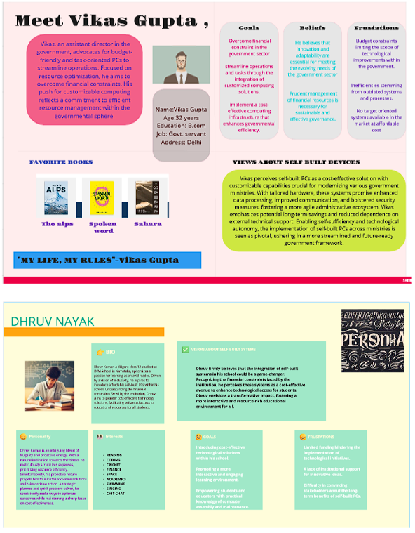
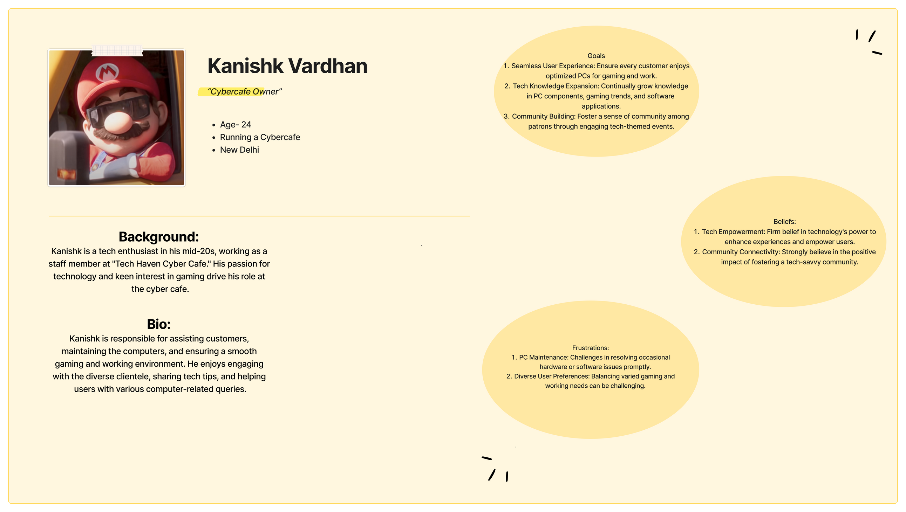
PERSONAS
06

Slide 8

PERSONA 1

Slide 9
PERSONA 2

Slide 10
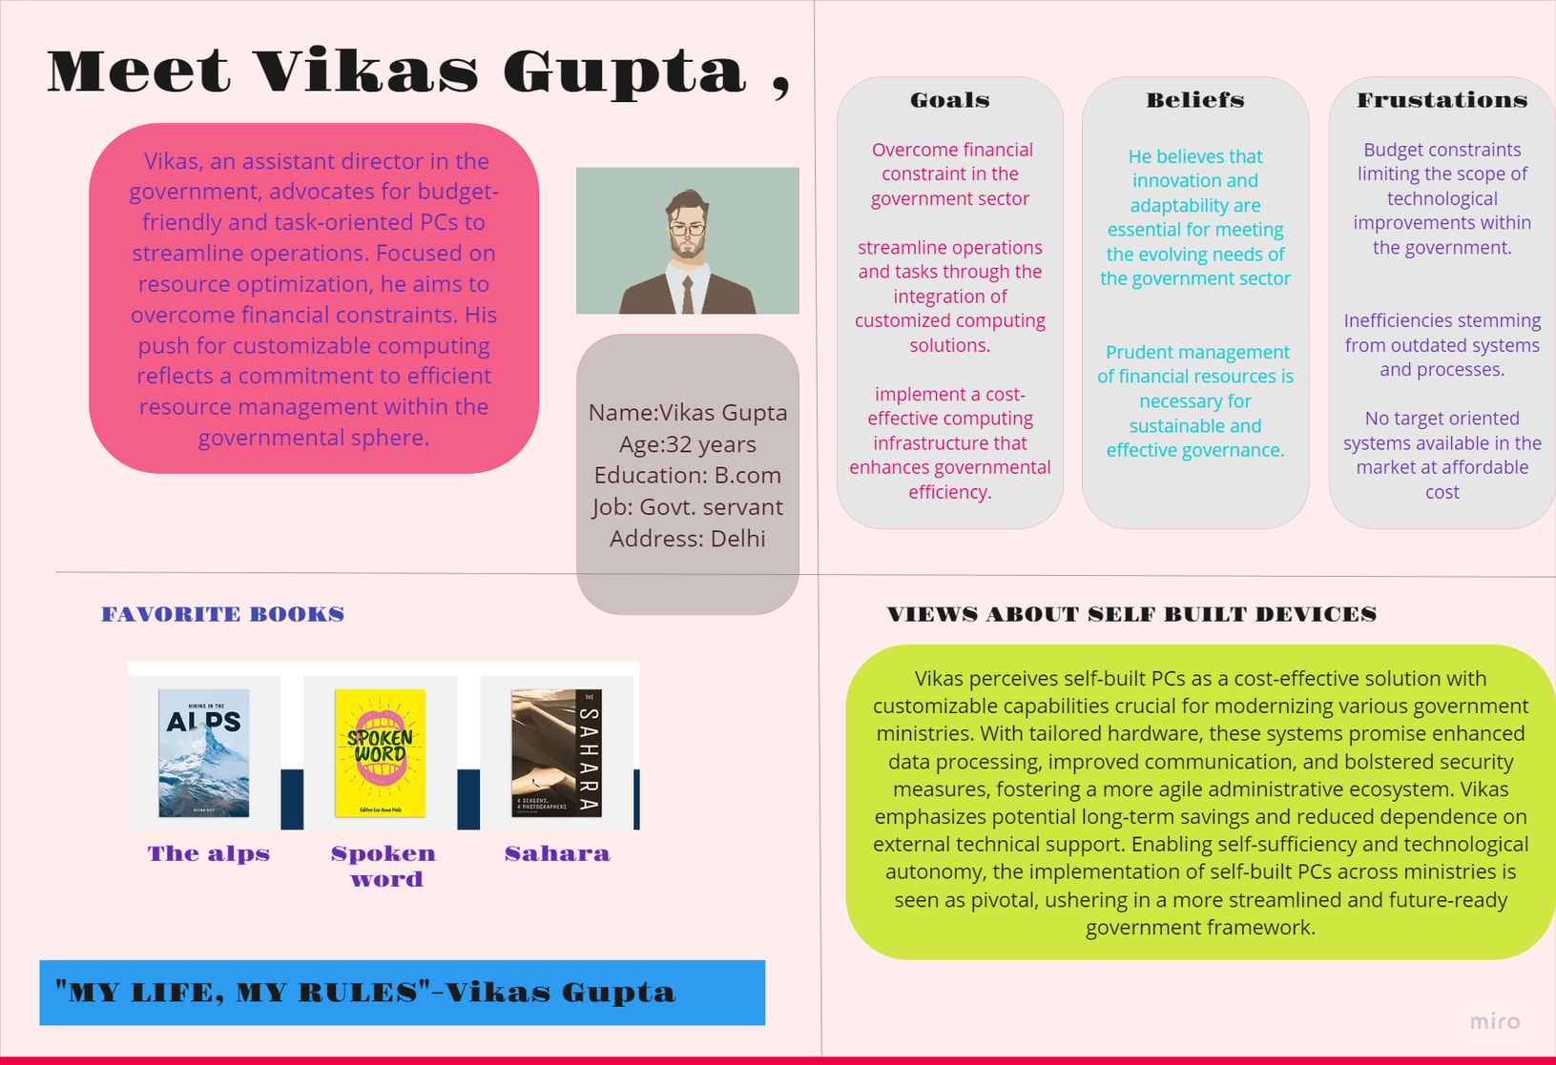
PERSONA 3

Slide 11
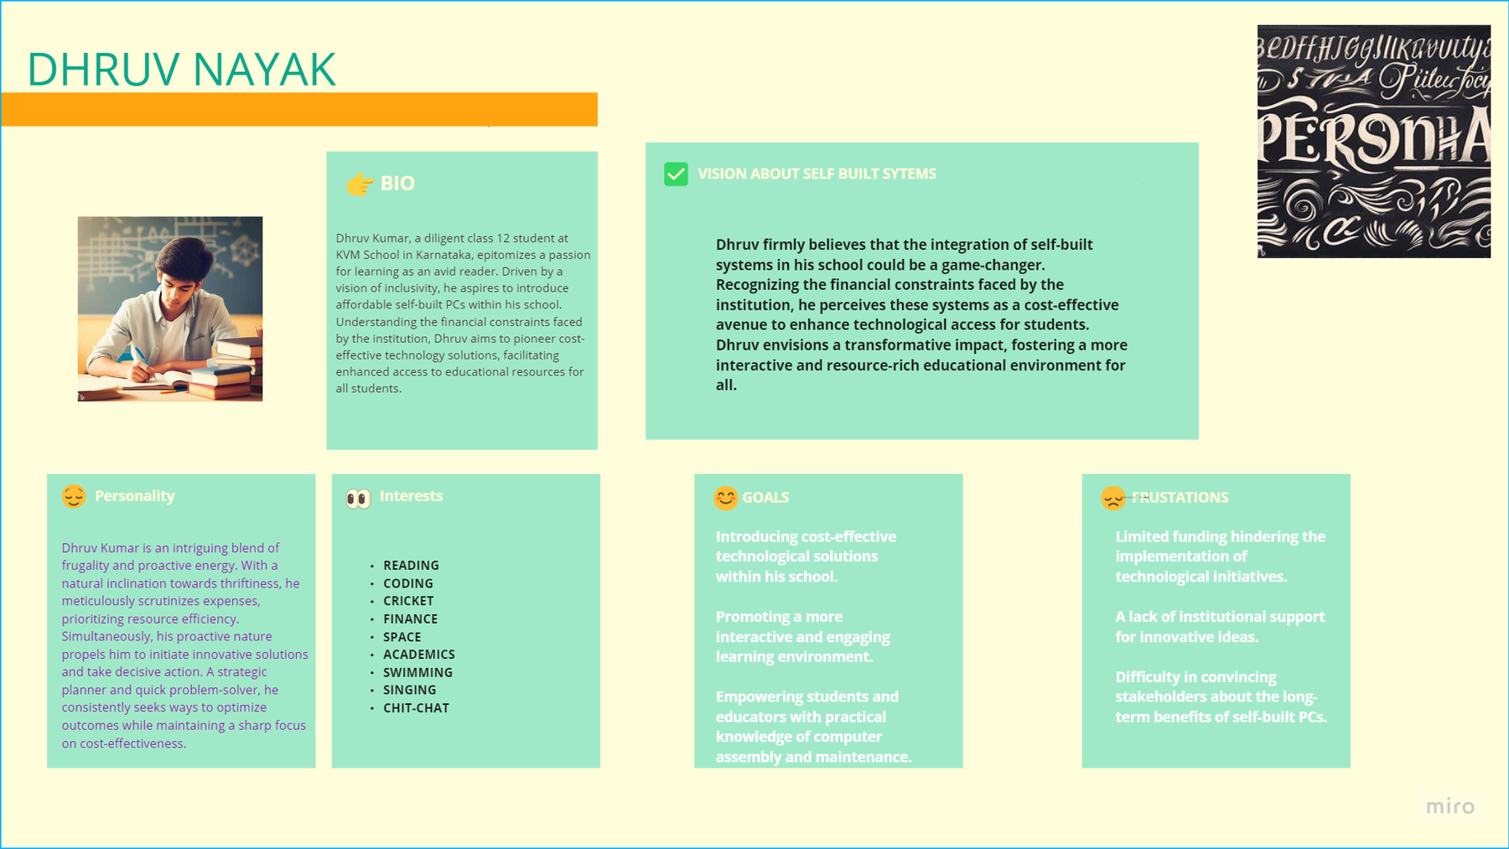
PERSONA 4

Slide 12
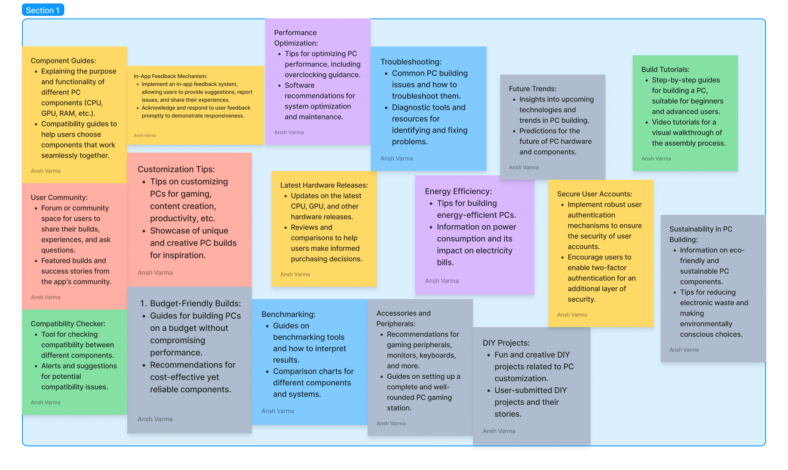
BRAINSTORMING!!

Slide 13
SCENARIO

Slide 14
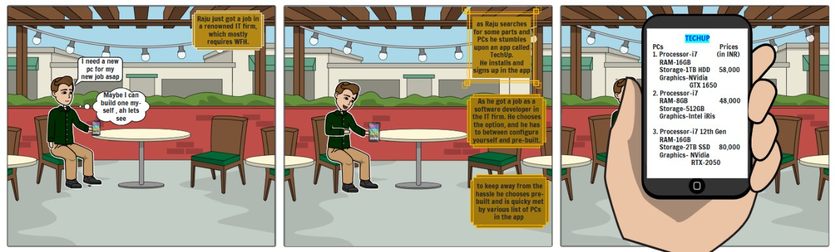
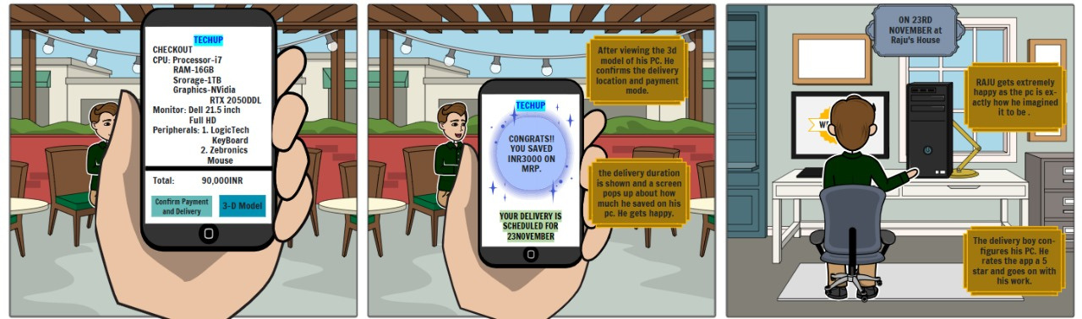
Scenario
07

Slide 15
EMPATHY MAPPING

Slide 16
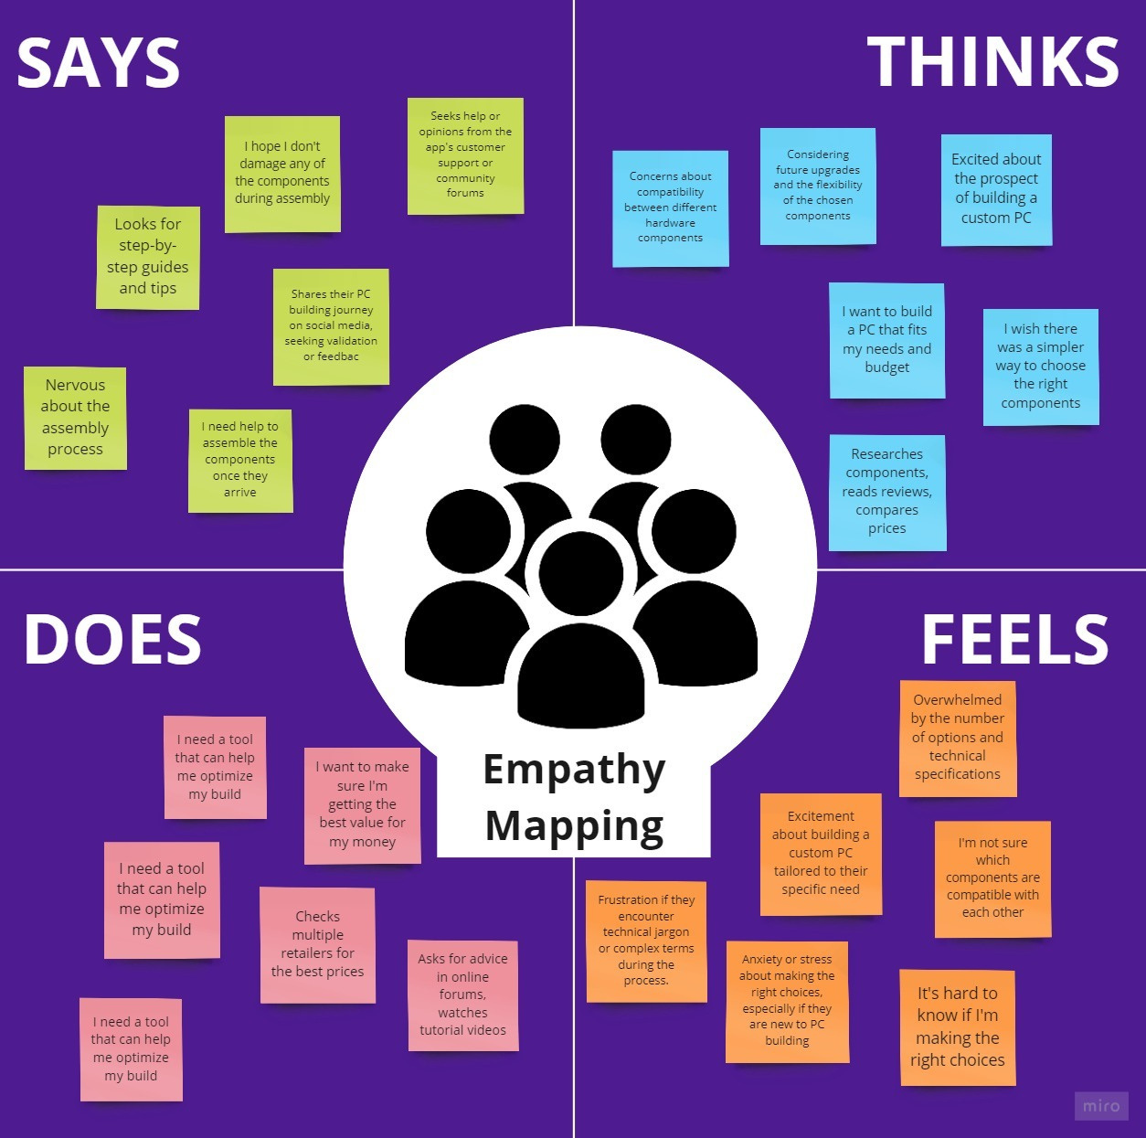

Slide 17
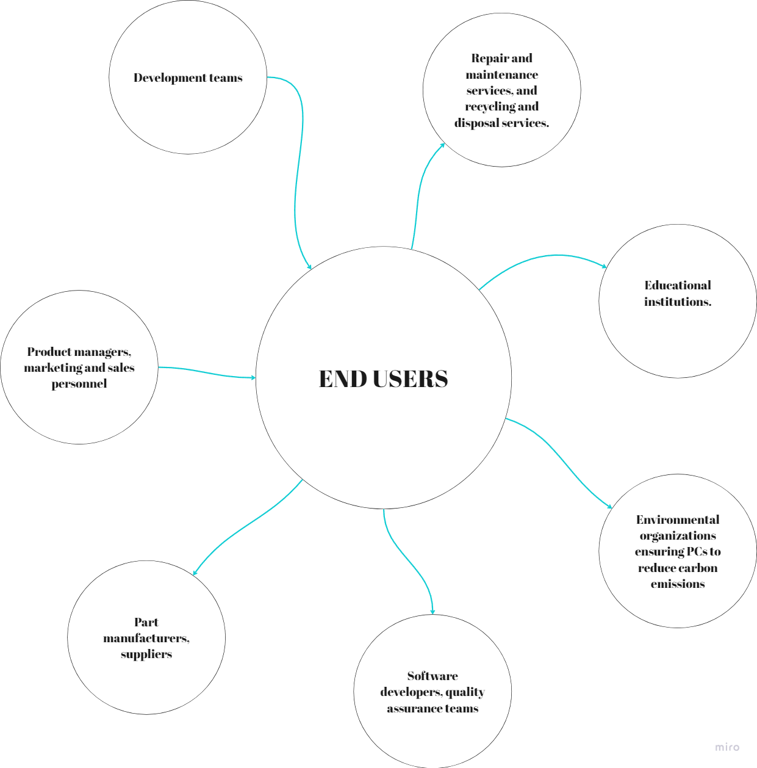
PROBLEM UNDERSTANDING

Slide 18
14
3.DEVELOP

Slide 19
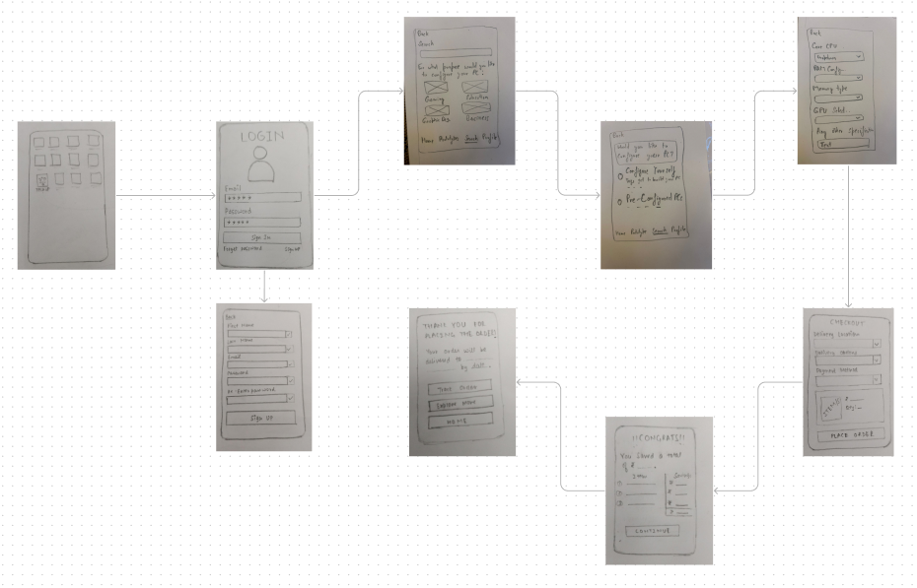
LOFI DESIGNS

Slide 20
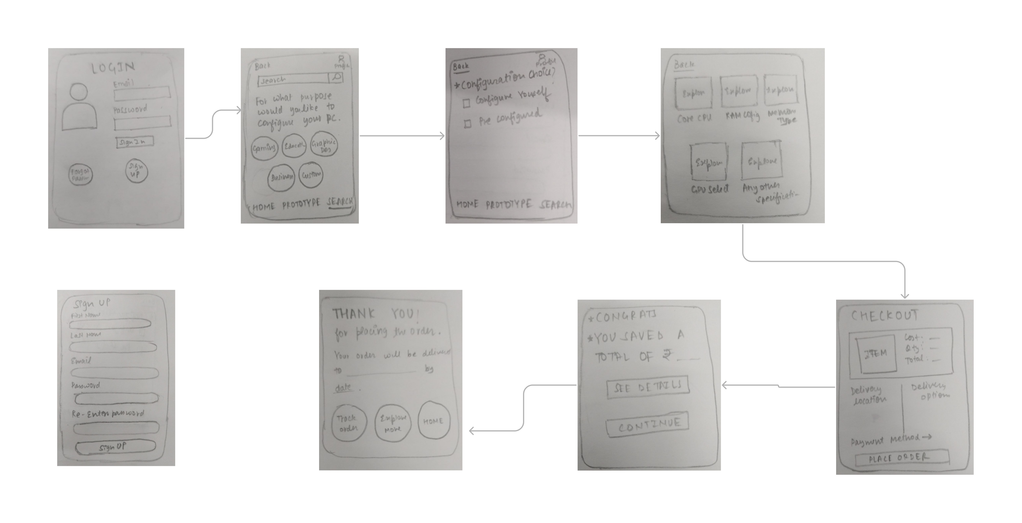
LOFI DESIGNS

Slide 21
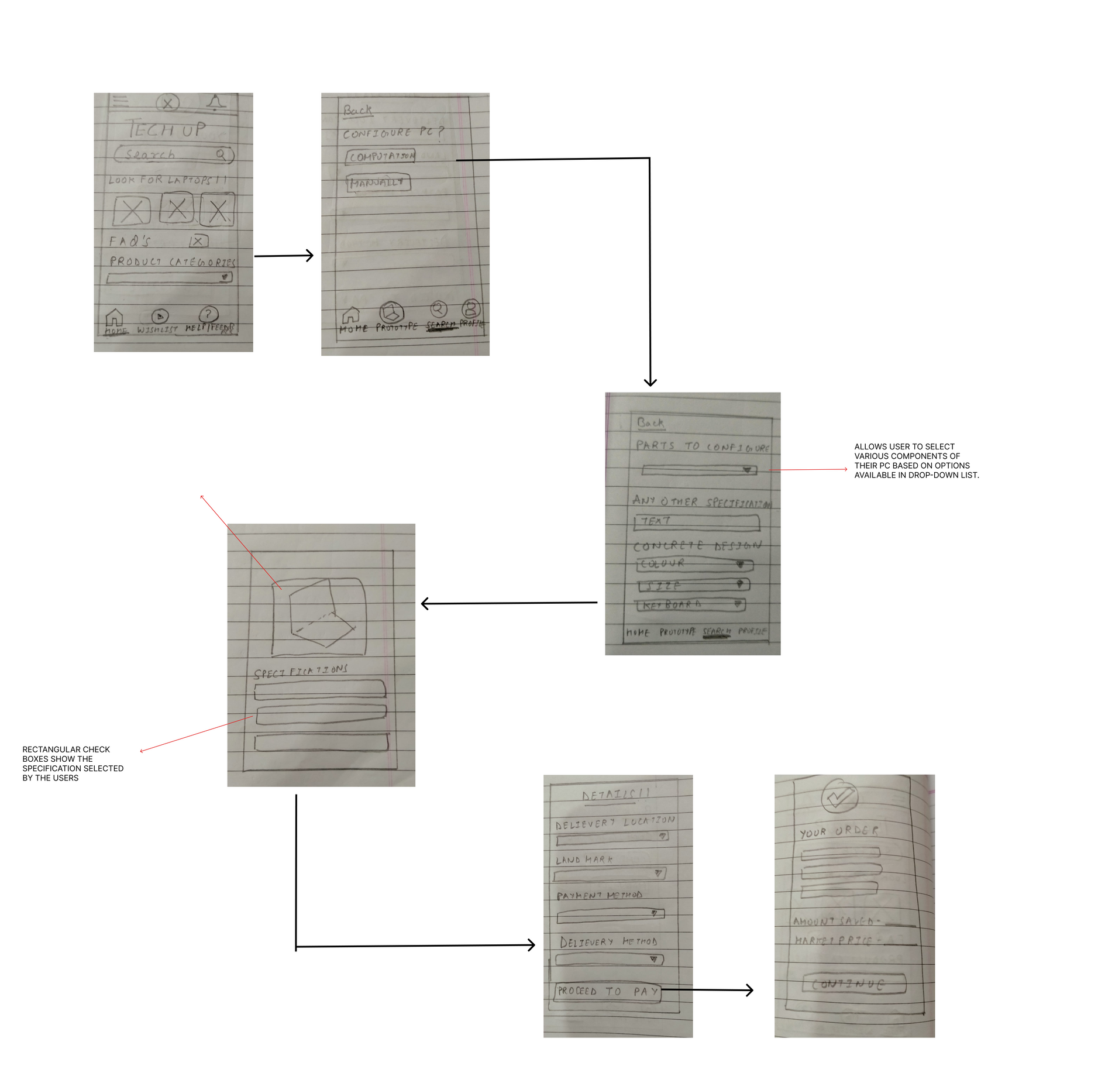
LOFI DESIGNS

Slide 22
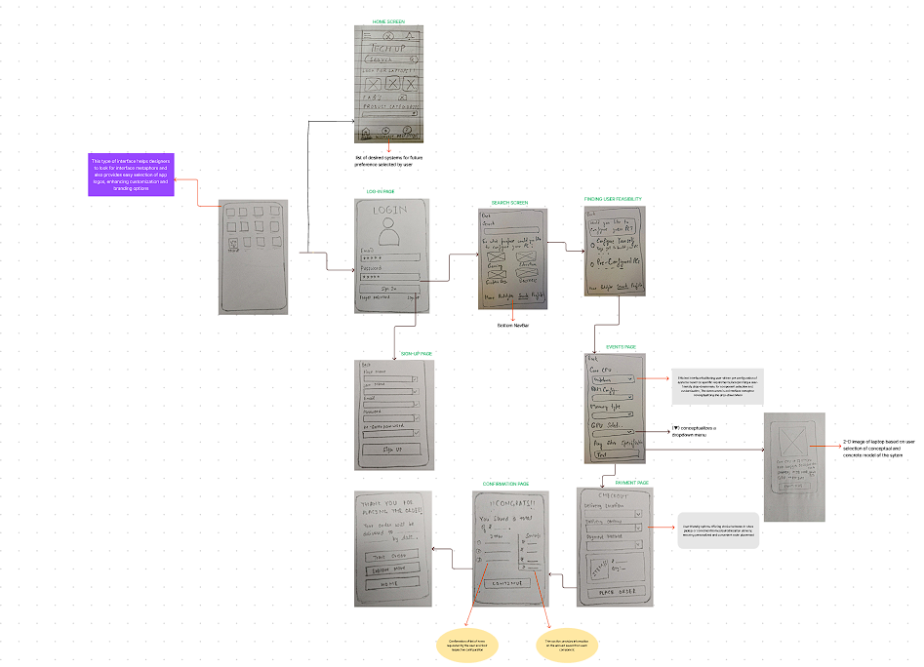
FINAL LOFI DESIGN

Slide 23
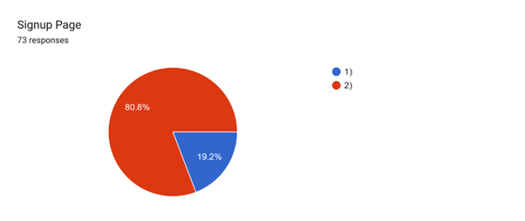
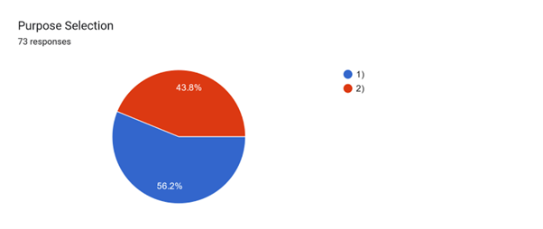

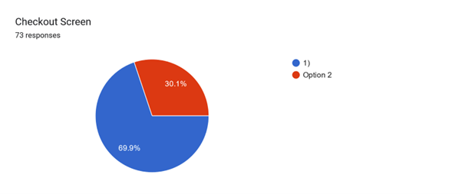
LO-FI EVALUATION

Slide 24
TAKEAWAYS FROM EVALUATION
BENEFITS OF THE DESIGNS:
When presented with the second low-fidelity design, feedback highlighted its simplicity and minimalistic approach, meeting the criteria of being well-rounded and adhering to design principles like Gestalt's laws and Fitt's law. The third design received positive comments for its efficiency in guiding users through the steps with minimal yet essential information, particularly appreciated by one participant for its homepage design. The first design, considered the most elaborate, was favored for its login page and search menu, aligning with Fitt's Law and achieving a balance between reducing user mental load and providing necessary information.
Challenges of the Designs:
Critiques for the third design included a perceived heavy mental load due to limited steps and an abundance of information. Although the second design received overall positive feedback, concerns were raised about incomplete information provision, impacting task efficiency. The first design, characterized by a minimal and simple homepage, was acknowledged for its simplicity.

Slide 25


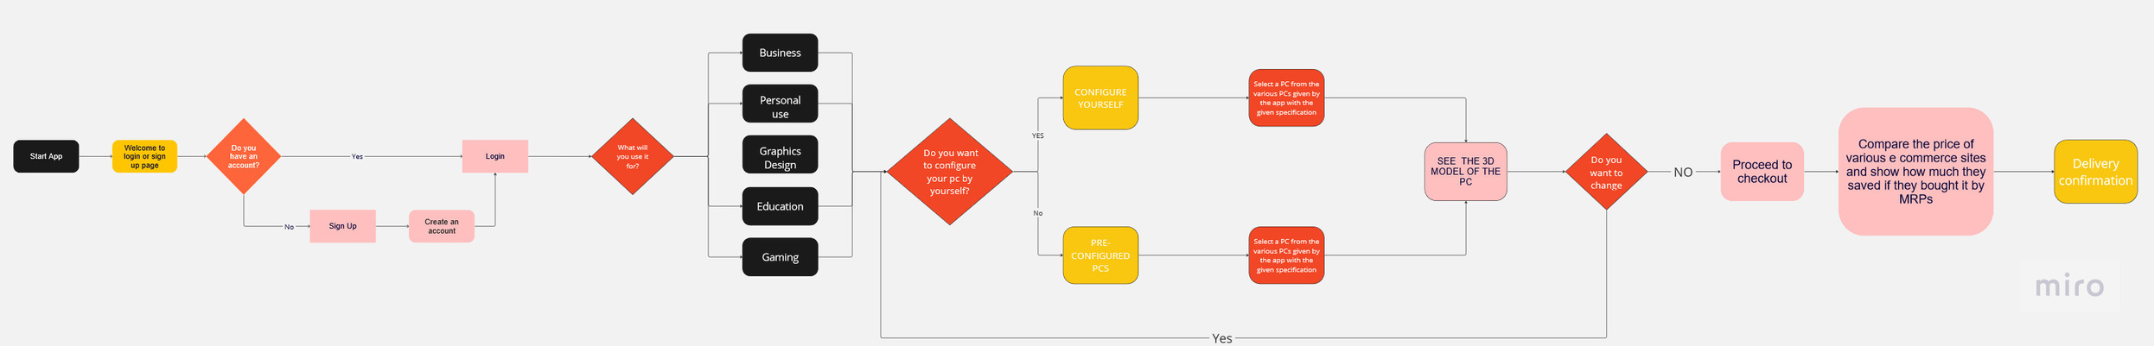
Efficient app flow
User Authentication:
Users begin by logging in or signing up, directing them to their respective account pages based on their account status.
User Preferences:
Users are prompted to indicate their preferences, such as interests in education, coding, etc., enabling personalized recommendations.
Configuration Options:
Users choose between two configuration methods:
Self Configuration: Manually selecting individual PC parts.
Pre-Customization: Receiving pre-configured PC options based on previously stated preferences.
Visualization:
After configuration, users view a 2D model of the PC, allowing a concrete representation of the chosen design.
Review and Modification:
Users have the option to review and make changes to the configuration before finalizing the selection.
Payment and Checkout:
Once satisfied, users proceed to payment and checkout, completing the process for their custom-built PC.

Slide 26
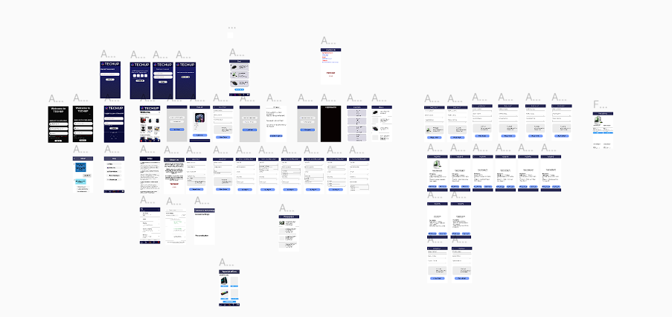
HIFI DESIGN

Slide 27
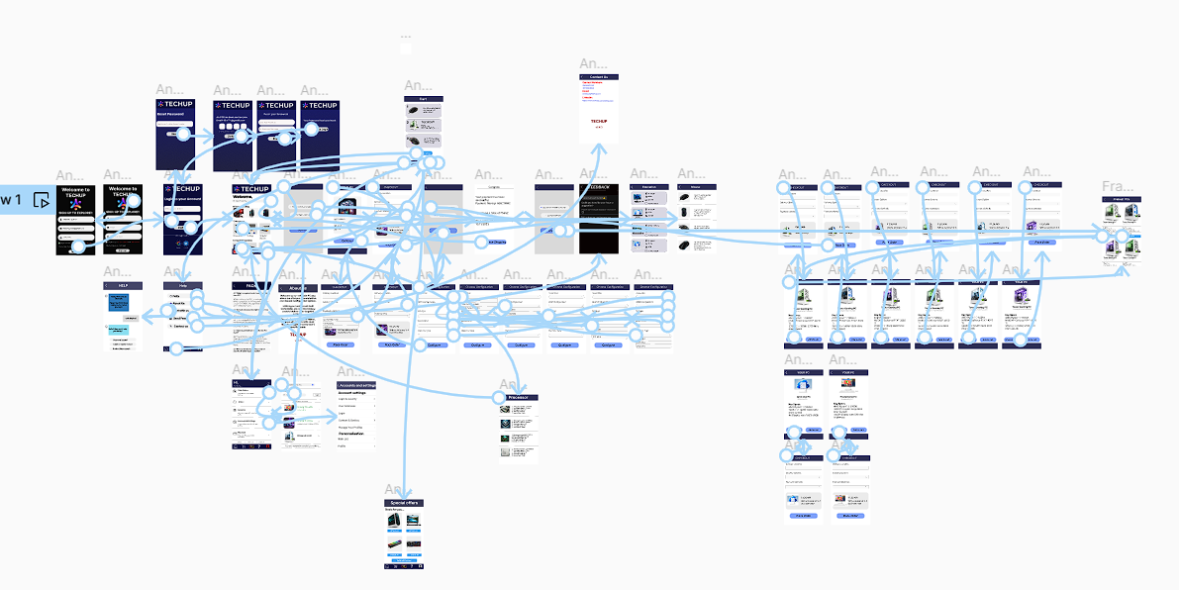
HIFI DESIGN FLOW

Slide 28

HIFI PROTOTYPE
FIGMA LINK

Slide 30
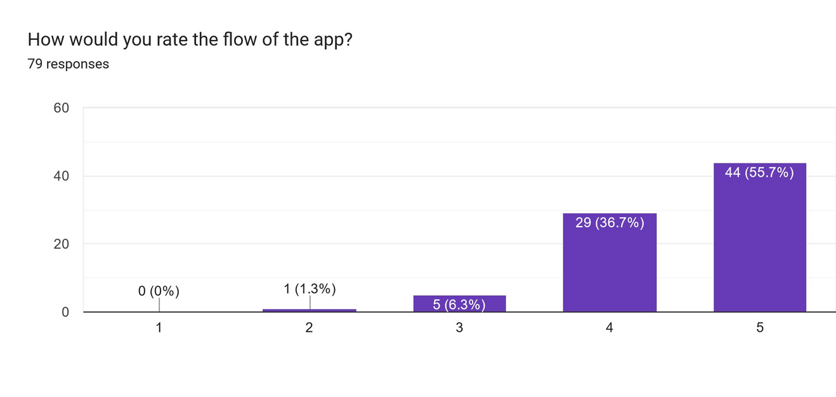
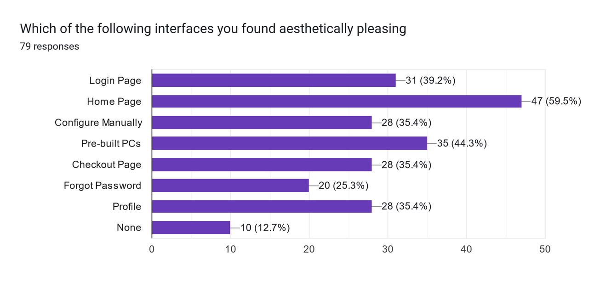
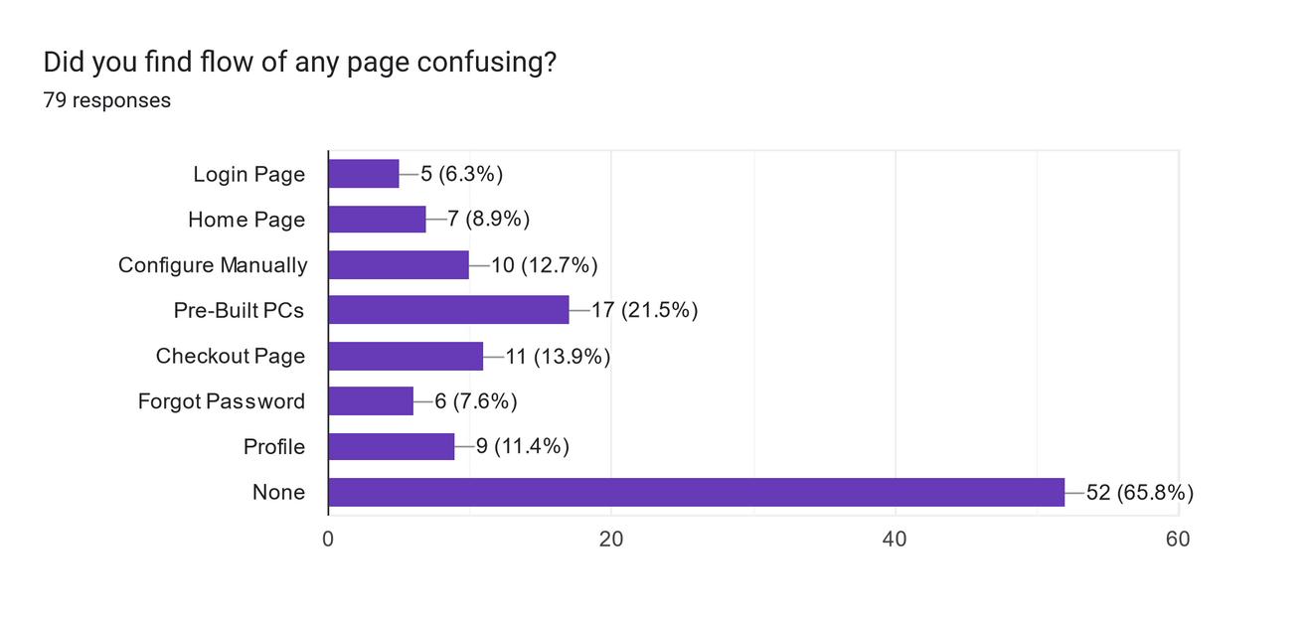
USER TESTING & EVALUATION

Slide 31
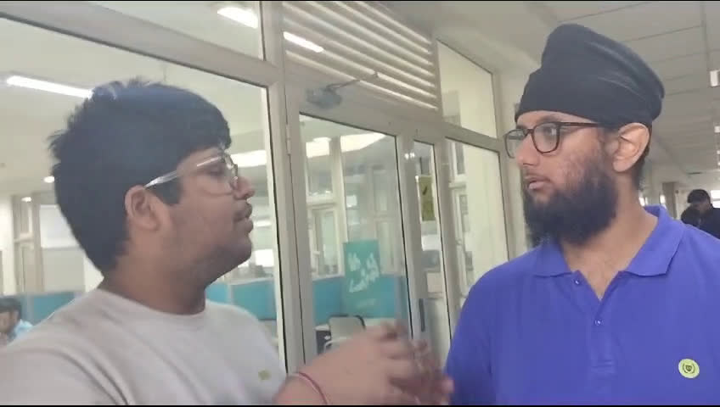
INTERVIEW
LINK TO THIS

Slide 32
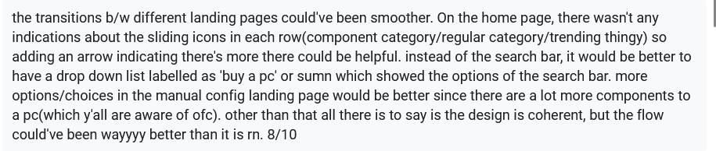
KEY SUGGESTIONS

Slide 33
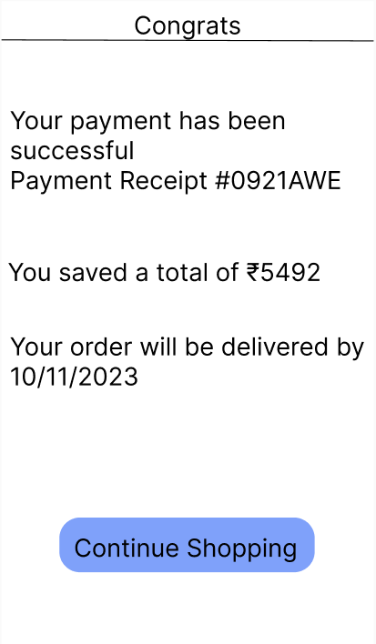
IMPROVEMENTS
BASED ON SURVEY FEEDBACK, PARTICIPANTS SUGGESTED ENHANCING TRANSPARENCY BY INCLUDING MARKET PRICES FOR PRODUCT COMPARISON. IN RESPONSE, OUR APP NOW DISPLAYS THE USER'S SAVINGS IN COMPARISON TO OTHER MARKET PRICES ON THE FINAL PAYMENT SCREEN. THE ADDITION OF THE SAVINGS DISPLAY ON THE FINAL PAYMENT SCREEN SERVES AS A TESTAMENT TO OUR COMMITMENT TO TRANSPARENCY AND ADDRESSING USER CONCERNS PROACTIVELY.

Slide 34
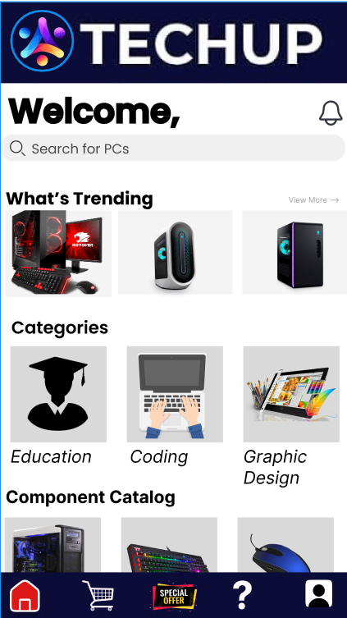
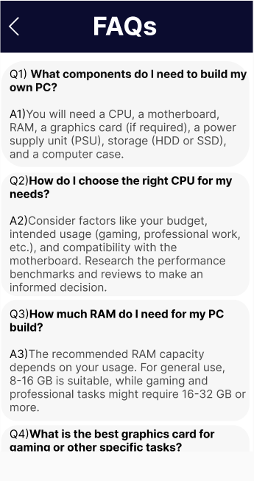
ADDITIONALLY, TO ADDRESS CONCERNS ABOUT UNCLEAR HORIZONTAL SCROLLING, WE IMPLEMENTED A "VIEW MORE OPTIONS" FEATURE.
Recognizing that some users found it challenging to determine the right components for their PC, particularly novice users, we introduced a comprehensive FAQ section. These refinements were guided by user input, aiming to improve clarity, user understanding, and overall usability

Slide 35
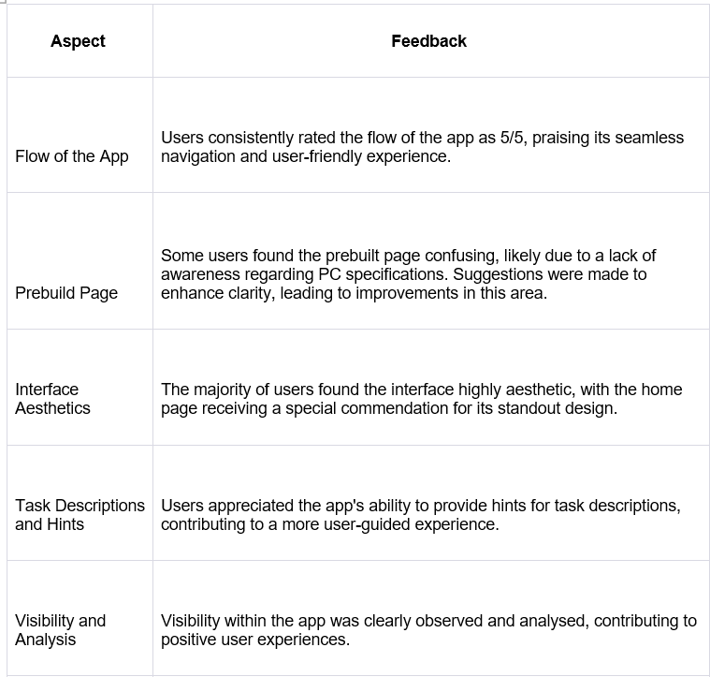
LEARNINGS FROM USER TESTING & EVALUATION

Slide 36
14
4.DELIVER

Slide 37
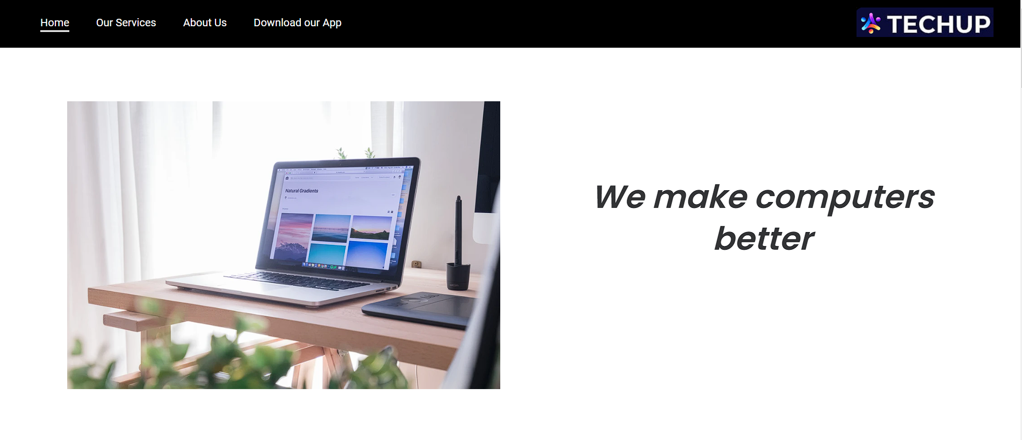
WEBSITE

Slide 38
LINKS
WEBSITE
HIFI
SLIDES(CANVA)

Slide 39
LEARNINGS AND REFLECTIONS
THE LEARNINGS OF OUR GROUP DURING THE SELF-BUILD PC APP DEVELOPMENT JOURNEY WERE PROFOUND. ENGAGING IN INTERVIEWS WITH A DIVERSE ARRAY OF STAKEHOLDERS EMERGED AS A TRANSFORMATIVE EXPERIENCE, ENABLING US TO COMPREHEND TECHNICAL REQUIREMENTS AND EMPATHIZE WITH USERS FROM VARIED BACKGROUNDS.
THE SIGNIFICANCE OF BALANCING MANUAL AND PRE-CUSTOMIZATION OPTIONS, REVEALED THROUGH ITERATIVE DEVELOPMENT, HIGHLIGHTED THE IMPORTANCE OF FLEXIBILITY.
INCORPORATING VISUALIZATIONS, SUCH AS 2D MODELS, WAS INSTRUMENTAL IN FACILITATING USER FEEDBACK AND INFORMED DECISION-MAKING. ADDITIONALLY, THE EMPHASIS ON A SECURE AND STREAMLINED PAYMENT PROCESS
UNDERSCORED THE IMPORTANCE OF A SEAMLESS USER EXPERIENCE. COLLECTIVELY, THESE INSIGHTS SHOWCASE OUR COMMITMENT TO CONTINUAL REFINEMENT, INCLUSIVITY, AND RESPONSIVENESS TO DIVERSE USER NEEDS THROUGHOUT THE APP DEVELOPMENT PROCESS.

Slide 40
THANK YOU

